Slide 1


Slide 2
Group Members:
Muhammad Sabir (18k-1158)
Ritik (18k-0130)
Muhammad Taha Mir (18k-0147)

Slide 3
Ration distribution during COVID-19 lockdown

Slide 4
Problem:
We worked on ration distribution project. Its difficult for people to earn money during quarantine. So they can’t feed their lives. Pakistan don’t have a proper system to distribute ration among all homes. So we made application that works for ration distribution by having a record of whole Pakistan. We make it to send the ration to each house especially which are more in need based on priority level or distance.

Slide 5
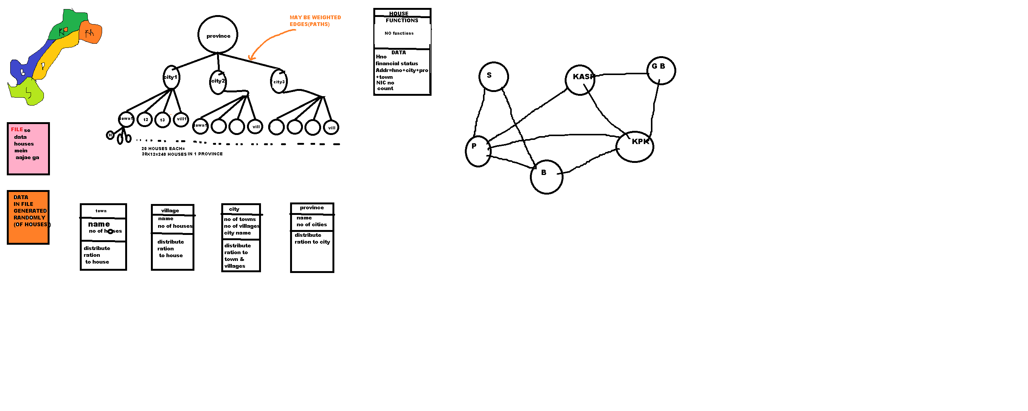
The graph and tree work of provinces:

Slide 6
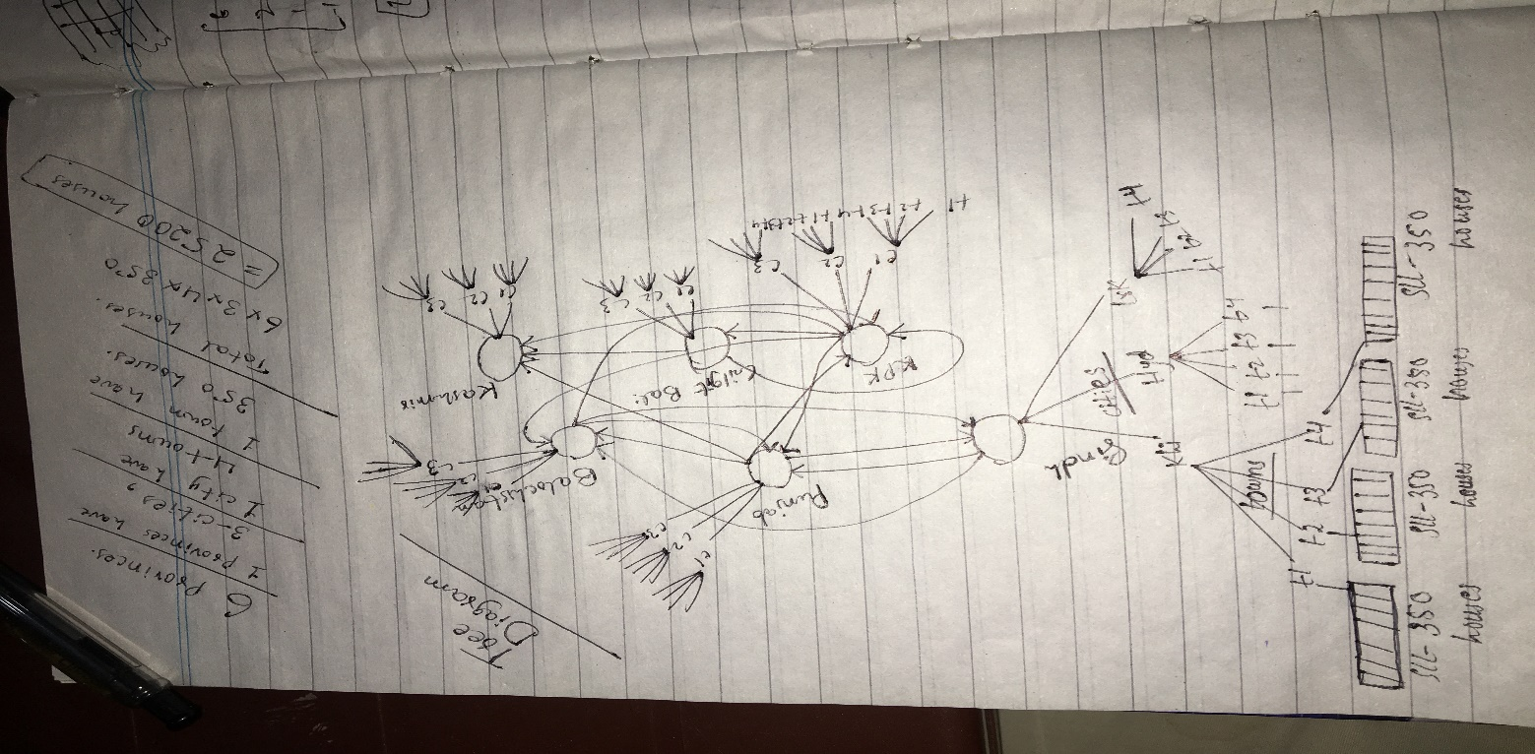
The elaborated diagram of tree:
Elaborated Model

Slide 7

Solution for problem(SUMMARY):
We solve the problem by implementing the model of Pakistan. We have made a model for six provinces (Sindh , Punjab , KPK , Baluchistan , GB ,Kashmir) every province has 3 three cities and every city have 4 towns and every town has 4200 houses. Each house has its own unique address. We have made trees for the cities and towns and linked list for houses of every province. A survey is taken to select the needy houses. On the other hand People requests for ration is also dealt.

Slide 8
Solution(Explanation)
Modelling Pakistan(Structure)
-Used Trees , Linked list , Array ,Heap
Data Generation
-Generated random data.
DATA+STRUCTURE==DATA_STRUCTURE.
Algorithms
-Survey
-Requests

Slide 9
-Requests
User sign’s in to his house account , from there he can request ration.
In request.txt file records of houses can be dealt in two ways
1. Highest priority element is dealt first,after sorting on the bases of priority level using Heapsort .
2.Nearest houses are dealt first ,after sorting according to Addresses.

Slide 10
Delivering Ration
A function Goto_House() takes the address from file(request.txt or survey.txt) (which are already sorted based on either addresses or priority) and goes to that address to deliver ration(increments ration count(a data member in house) by 1).
As the count is incremented in the running program’s local variable , Pakistan.txt file is also modified (in it also at that address the count is incremented and the rest of file is unchanged)
-Goto_House() function is actually used to reach any house taking house address as parameter.

Slide 11

-Survey
A survey will be conducted in whole country which selects needy houses based on priority number.
Priority number= (tp*(if+1)) / ((rc+1)*s)
->Average priority no. of whole country is calculated.
->Then each house of country is traversed and is selected if that house’s
Priority no. is greater than the average priority.
->Selected houses Address and priority are taken into a survey.txt file,
In survey file records of houses can be dealt in two ways
1. Highest priority element is dealt first,after sorting on the bases of priority level using Heapsort .
2.Nearest houses are dealt first ,after sorting according to Addresses.

Slide 12
Data structures
Following data structures have been used.
Tree
Linked list
Heap
Array

Slide 13
Operations
Searching for house.
PRIORITY WISE HEAPSORT
SORTING A/C TO ADDRESS
DEALING WITH REQUESTS
TAKING SURVEY
EDIT HOUSE DATA
DELIVER RATION
SET RATION QUANTITY
RANK PROVINCES
VIEW FILE RECORDS

Slide 14
How our solution fits the problem
We may have used Multi dimensional array to store our data , but it would takes a lot of time to traverse through it.
Our customized tree helps to reach any town in constant time , from there on it takes just O(n) time to reach the specified house.

Slide 15
Limitations and future work:
Limitations
This is only a model of Pakistan. Actual Pakistan is not depicted.
Graphics not added.
Future work
It will help us to bring the ration to every house in emergency case as now of corona situation.
Whole Pakistan may be modeled.
Real data may be taken from somewhere.

Slide 16
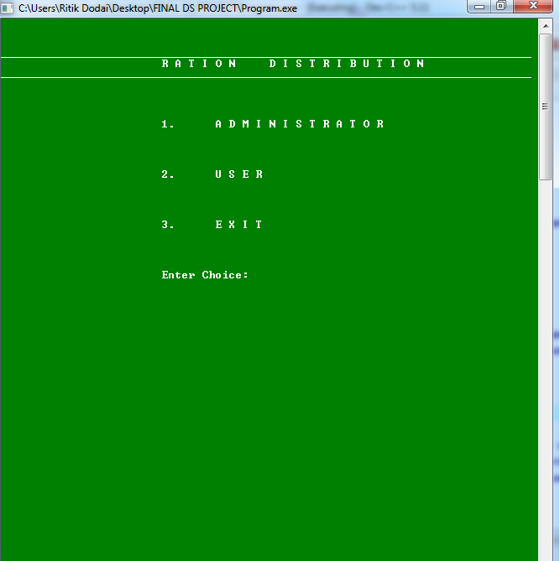
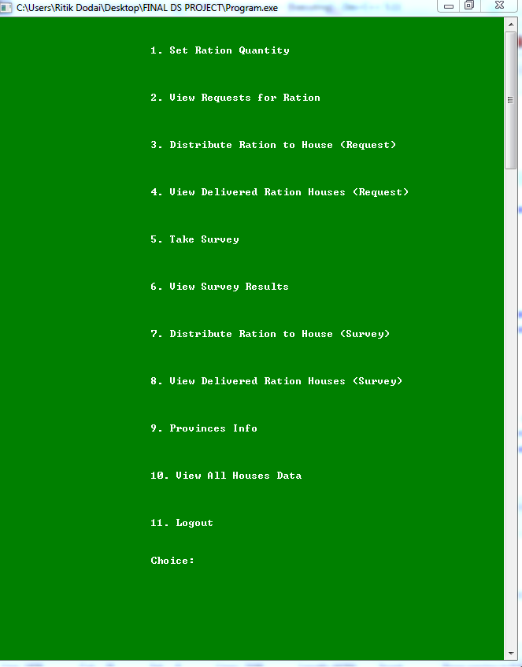
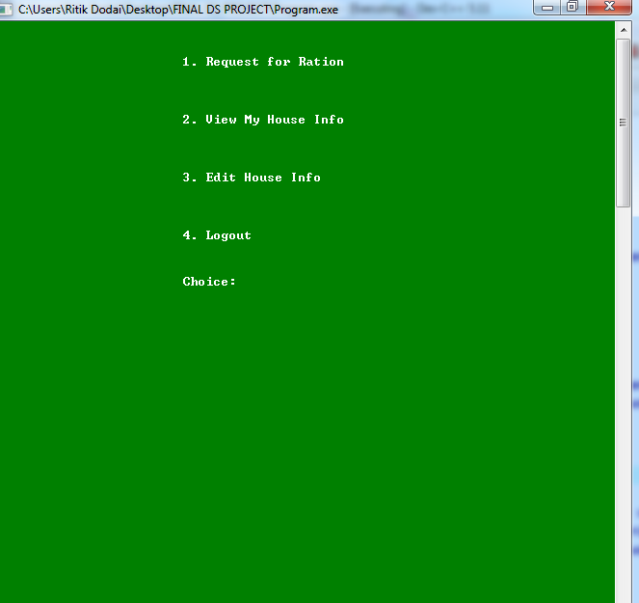
Software inputs + outputs

Slide 17
Contribution
MUHAMMAD TAHA MIR
Province and city nodes
Generated Pakistan data
User requests
Reach to house directly by giving address function
Heap sort
Conditions for selecting houses
Priority= ( tp*(if+1) )/(s*(rc+1))

Slide 18
Contribution
MUHAMMAD SABIR
1. Ranking province info ( no of cases and priority value )
2. Houses singly linked list
3. Sort houses by address

Slide 19
Contribution
Ritik
1. Town nodes
2. Generated Pakistan data and store in each house
3. whole work of Survey
4. Administrator and user complete login system
5. edit data function ( which updates data in Pakistan file )
6. Heap sort
7. Set ration quantity function
8. Distribute ration function
9. Complete code finishing ( compiled all members work )

Slide 20
What we have learned from this project.
TAHA MIR
It was a nice experience doing the whole project online. 2.While debugging a bug I realized the importance of static data members(explain). 3.Working together. Suggestions 1.If the projects were not confined to COVID only then more creative stuff may have been possible. 2. I think if only online classes could be made a little more better like providing teachers and students stylus so that they can write on screen and exams could be held online by some idea then it will be great.
RITIK
I have learned that:
How can we select appriopriate data structure for a given problem.
How to handle data and utilize it in the problem algorithms.
Also by doing this project my programming skills get better by dealing with bugs and code for a long time.
Suggestions:
If we had board in online classes so it might be easy for us to understand the lecture.

Slide 21
SABIR
Learned:
I am little bit week in filing so I learned filing.
Teamwork
I have learned how we connect nodes with reference.
Suggestions:
I think backtracking is little complex so we have to concentrate on backtracking

Slide 22

Thank you

